Slide 1
Joins in MySQL
By
Tejaswini K

Slide 2
Introduction
1. It is used to retrieve data from multiple tables.
2.It is performed whenever you need to fetch records from two or more tables.
Types of Joins:
1. MySQL INNER JOIN (or sometimes called simple join)
2.MySQL LEFT OUTER JOIN (or sometimes called LEFT JOIN)
3.MySQL RIGHT OUTER JOIN (or sometimes called RIGHT JOIN)

Slide 3
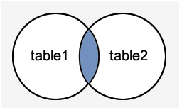
MySQL Inner Join(Simple join)
It is return all rows from multiple tables where the join condition is satisfied.
Syntax :
SELECT columns
FROM table1
INNER JOIN table2
ON table1.column = table2.column;

Slide 4
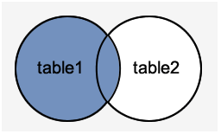
MySQL Left Outer Join
It returns all rows from the left hand table specified in the ON condition and only those rows from the other table where the join condition is fulfilled.
Syntax :
SELECT columns
FROM table1
LEFT [OUTER] JOIN table2
ON table1.column = table2.column;

Slide 5
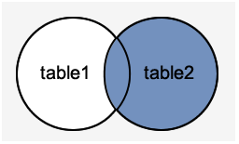
MySQL Right Outer Join
It returns all rows from the RIGHT-hand table specified in the ON condition and only those rows from the other table where he join condition is fulfilled.
Syntax :
SELECT columns
FROM table1
RIGHT [OUTER] JOIN table2
ON table1.column = table2.column;

Slide 6

Thank You….!

